Slide 1
Improving Your DBA Skills
The Tools to Get You There
Michael Cunningham
http://www.michaelwcunningham.com

Slide 2
Earn an #IOUGenius Certificate Demonstrate the skills you’ve gained at COLLABORATE 16
12c New Features and Upgrades
Core DBA Skills
Oracle Enterprise Manager
Performance
Securing Your Oracle Database
Techniques for High Availability
The Cloud, Options, and Choices
Understanding Big Data, Tools, and Techniques
WebCenter Strategies and Best Practices
How to Earn Your Certificate
Choose a certificate that benefits you and your company the most.
Search for sessions mobile app device by using the hashtag #IOUGenius.
“Check-in” to 4+ sessions on your mobile app.
Email us at speakers@ioug.org to receive your #IOUGenius e-certificate(s).
Visit: collaborate.ioug.org/certificates

Slide 3


Who am I?
Michael Cunningham
Software Engineer for 10 years
DBA for 13 years
Hobbies
Sailing
Archery
RVing
Snow Skiing
Backpacking
Winemaking

Slide 4
Newest Hobbie – T-Shirt Design

Slide 5
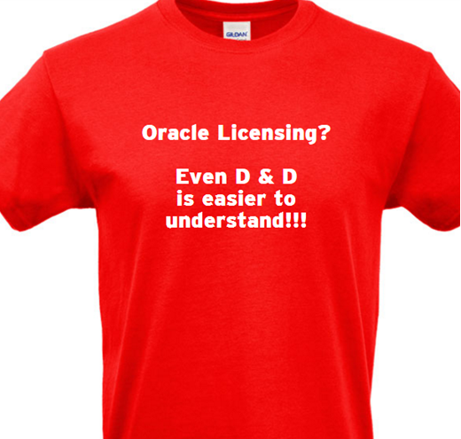
My First T-Shirt Design

Slide 6
Introduction
WHY?
What skills other experts say all DBA's should possess
How to improve those skills and others
What worked for me

Slide 7
Why I think a talk like this is valuable?
Questions I see on forums
How can I get up to speed – I was thrown into this position
I'm a new DBA, where should I begin learning?
How do I grow my DBA career?
How do I become a DBA guru?

Slide 8
Why I think a talk like this is valuable?
Questions I see on forums
How can I get up to speed – I was thrown into this position
I'm a new DBA, where should I begin learning?
How do I grow my DBA career?
How do I become a DBA guru?
Answers I see on the forums
Start with the Oracle Concepts Manual
Great advice and I also recommend it, but 646 pages
User Group meetings (not just Oracle groups)
Conferences – talk with others and trade war stories
Read blogs, articles, books
Switch Careers

Slide 9
The Road To Improvement
10,000 hours to become proficient
exceptional expertise requires at least 10,000 hours of practice

Slide 10
The Road To Improvement
10,000 hours to become proficient
exceptional expertise requires at least 10,000 hours of practice
Some say this is a myth and I tend to agree

Slide 11
The Road To Improvement
10,000 hours to become proficient
exceptional expertise requires at least 10,000 hours of practice
Some say this is a myth and I tend to agree
My experience to learning
Compuserve (read and learn from others)
Articles (read them and write them)
Book (Application Express)
Constant search for improvement and personal growth
Willing to be wrong

Slide 12
How To Get Started & Some Ideas

Slide 13
Make A List Of What Interests You
Make a list of topics that you find interesting
Forums
Blogs
Ask others what they have been doing
Job postings
Prioritize your list

Slide 14
Self Study
Build Your Own Curriculum And Classroom For Learning
Colleges do this and so can we
Set goals by writing an outline (like a curriculum)
Use Oracle docs, blogs, forums to gain knowledge
Keep track of them in a document (for reference)
Build a virtual environment to practice on
(requires good computer/laptop with big RAM)
Build a base system to copy
Different versions of Oracle and Linux

Slide 15
Making The Time For Improvement
Find the time that works best for you
I had this trouble (morning?, evening?, midnight? exercise?)
Get employer support
One hour per week dedicated to nothing but research
Try things, break things, fix them.
Spend time on forums
There is a whole community that loves to help
Oracle-L - http://www.freelists.org/list/oracle-l
Oracle Community - http://community.oracle.com

Slide 16
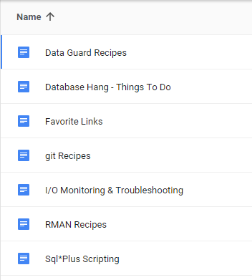
Staying Organized
Create yourself an online account to keep track of documents, etc.
Google has great online docs and searching them is very fast
If you are studying something like cache buffer chains put all the good links into your docs so you can recall them two months later
Make your own "recipe" docs while learning (very helpful)

Slide 17
Where I Go For Learning
Oracle-L forum
A single post led to a week or two of learning and research
Blogs
Subscribe with RSS feeds
I use "Feedly" on Android
Focused training – classroom
Conferences
Meet bloggers you learned from and thank them (don’t be shy)

Slide 18
Where I Go For Learning
Download the scripts from blog sites and read through them, test them out, learn the information they are seeking out
latchprofx.sql - high-frequency sampling on V$LATCHHOLDER
snapper.sql - session-level performance measurement tool
moats.sql - Mother Of All Tuning Scripts
OSM Toolkit – OraPub System Monitor (time-based analysis)
Oracle docs
New features – especially for major releases

Slide 19
Exposure to Topics Outside Our Environment
Example 1 - ASM Header Block Corruption
DBA experienced header block corruption when restarting ASM
Can go completely unnoticed unless you monitor for it.
When restarting ASM it will fail due to block corruption
Continues to run fine until the restart.
11g added md_backup and md_restore to asmcmd
Use kfed to repair the corrupted block

Slide 20
Exposure to Topics Outside Our Environment
Example 2 - Log File Syncs
Confusion was why log file parallel write & log file sync waits were so different between physical machine and virtual machine
v$event_histogram
AWR/Statspack Report: Wait Event Histogram section
Can make a good study for wanting to improve their knowledge of Log Files, the LGWR, and how different SGA sizes affect the size of the log_buffer.

Slide 21
Some Possible Areas of Study

Slide 22
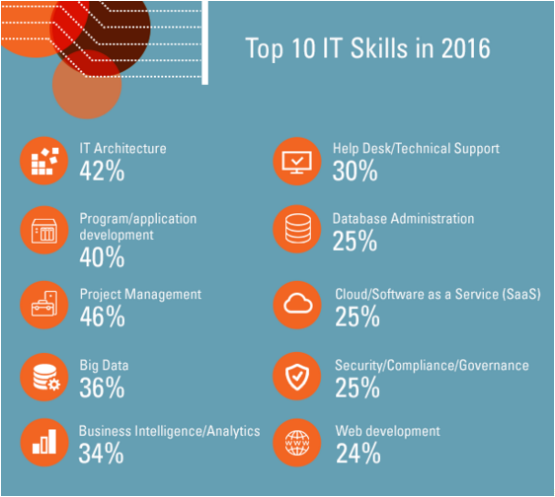
Top 10 IT Skills in 2016 – Oracle University Article

Slide 23
What Others Say DBA's Should Know
Backup and Recovery – test it (most important)
Linux/Windows – at least some such as install
Oracle installation
SQL – How to write it
PL/SQL – You will be asked to help developers
Data model design – for performance
Knowledge in scalability
Storage – Spinning disk vs. SSD
Understand the DB engine
The life of a transaction
pmon and smon and what they do
What are redo logs and why archive logs are important
File a Metalink support ticket

Slide 24
Become An Expert At Something And Share
ASH – Active Session History
RMAN backups
SAN storage - configuration, tuning, monitoring
SSD storage vs. Spinning rust
Automatic Storage Management (ASM)
Reading & understanding SQL execution plans

Slide 25
Become An Expert At Something And Share
Oracle Licensing – GOOD LUCK ! ! !
Implementing Oracle in the cloud
Application Express (Oracle focused forum)
Data Guard
I, personally, avoid high cost "options" not often used
Advanced Compression
Active Data Guard

Slide 26
My Favorite Bloggers & Why?

Slide 27
Bloggers Who I Learn From
Kyle Hailey
Great info on internals such as cache buffer chains and Kyle provides great graphs and pictures
Blog - http://datavirtualizer.com
Blog - http://blog.delphix.com/kyle - Delphix focused
Jonathan Lewis – Oracle Scratchpad
Anything performance tuning. Explains tuning very well at all levels. Deep internals knowledge is mind numbing.
Blog – https://jonathanlewis.wordpress.com
Other – http://allthingsoracle.com

Slide 28
Bloggers Who I Learn From
Craig Shallahamer – OraPub
OraPub helps Oracle DBAs take their tuning skills to the next level, though online, on-site training and webinars.
Blog – http://blog.orapub.com
Tanel Poder
Freakish scientific like mind that knows things other mortals don't. Writes well about understanding & tuning the internals of Oracle.
Blog - http://blog.tanelpoder.com
Scripts and tools - http://tech.e2sn.com/oracle-scripts-and-tools
Youtube - https://www.youtube.com/c/tanelpodertech

Slide 29
Bloggers Who I Learn From
Richard Foote – Index Internals
Blog - http://richardfoote.wordpress.com
Uwe Hesse – The Oracle Instructor
Writes classroom like blog posts
Data Guard, Exadata, others.
http://uhesse.com
Tim Hall – ORACLE-BASE
Blog - https://oracle-base.com/blog
Examples - https://oracle-base.com

Slide 30
Bloggers Who I Learn From
Kellyn Pov'Vin-Gorman
Oracle Enterprise Manager
Oracle-L
http://dbakevlar.com/
Others
Great all around info - http://www.toadworld.com
Ask Tom - http://asktom.oracle.com
Great Idea
http://blog.tanelpoder.com/2009/10/26/whats-a-good-way-to-learn-some-oracle-internals-every-day/

Slide 31
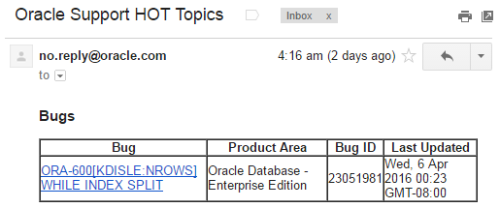
New Idea I Just Picked Up
What’s a good way to learn some Oracle internals every day?
Blog by Tanel Poder
Subscribe to metalink "Hot Topics E-Mail"
Email every day

Slide 32
Highly Recommended - Share Your Knowledge
Blog, Writing articles, Speaking
Writing about something forces you to learn it even better than you may have otherwise learned it
Write for User Group magazine like NoCOUG Journal
New features can be a popular thing to write about
Present at conferences
Spend time on the forums
Oracle-L is my favorite
Write a detailed white paper

Slide 33
Thank You
Please fill out the session evaluation
Further questions are welcome:
napacunningham@gmail.com
Blog
www.michaelwcunningham.com
Michael Cunningham

